Slide 1
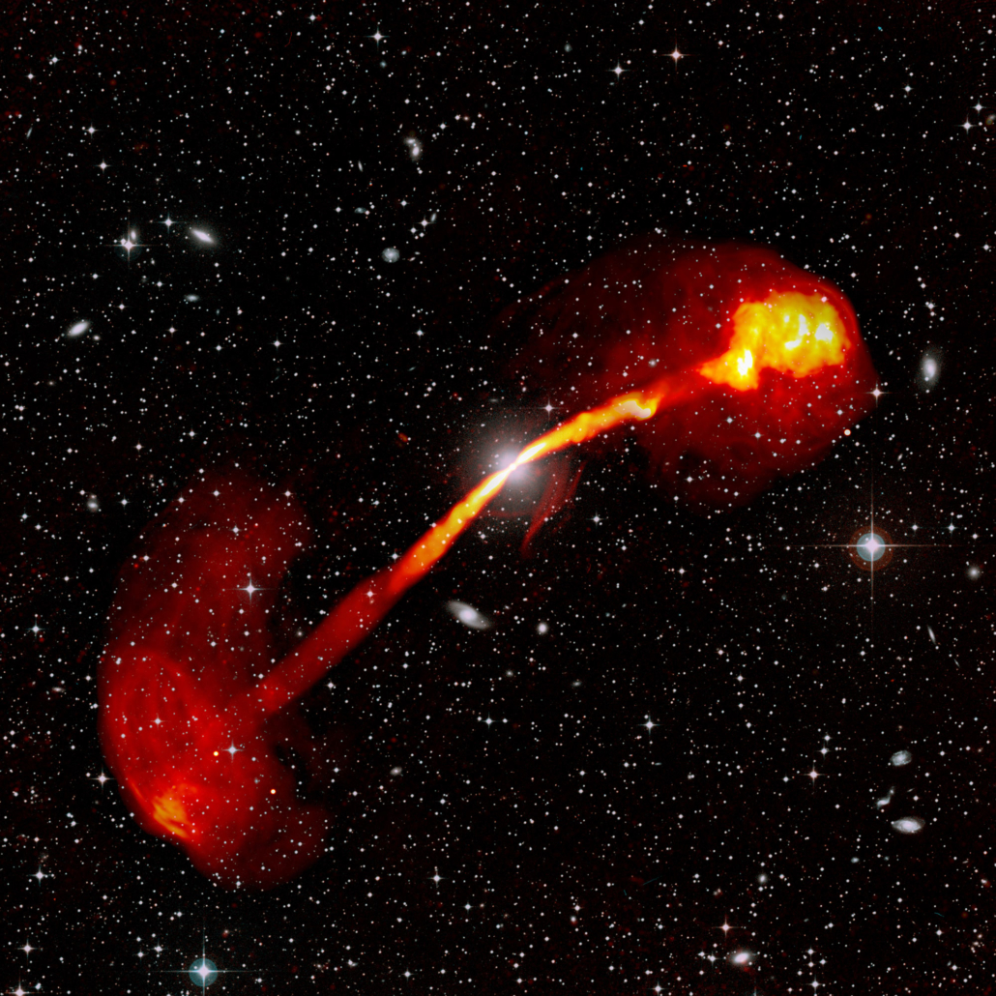
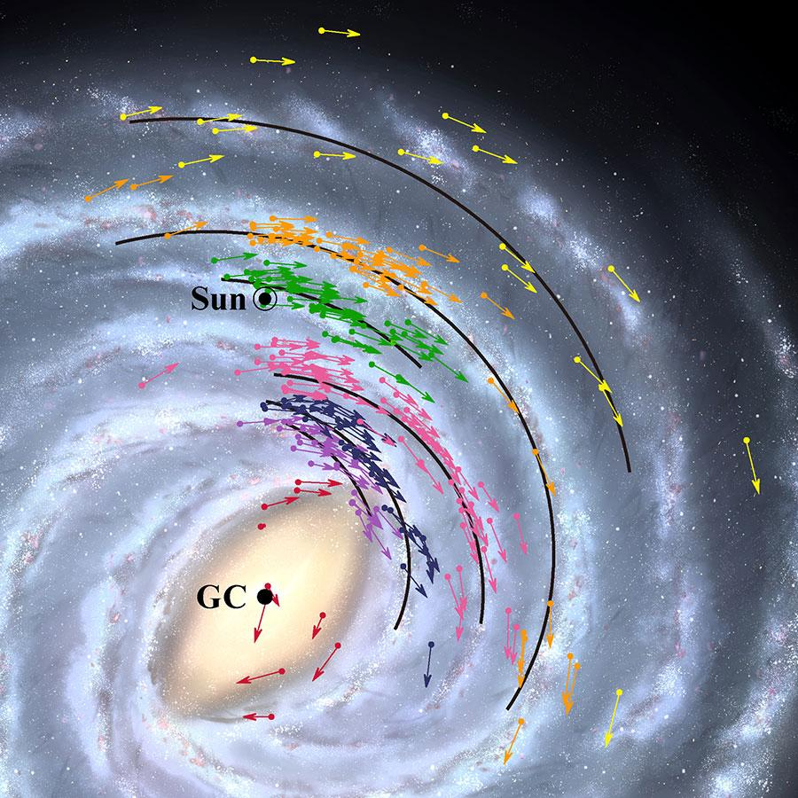
Radio Astronomy Observing Basics
KSP4.0 - Exploring the radio sky
Credit: SARAO, SSS, S. Dagnello and W. Cotton (NRAO/AUI/NSF)
Credit : NAOJ

Slide 2
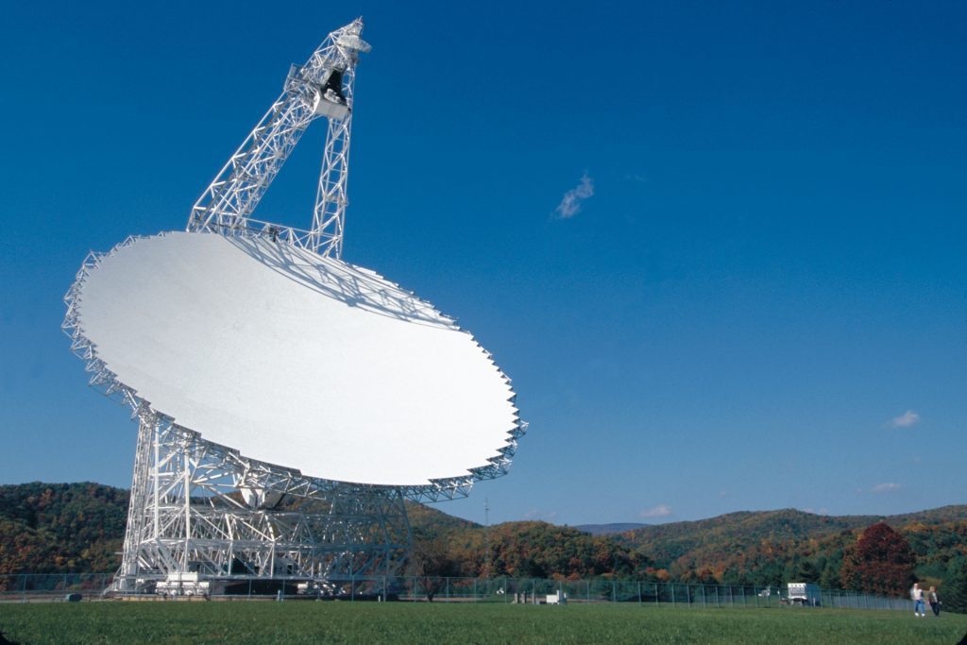
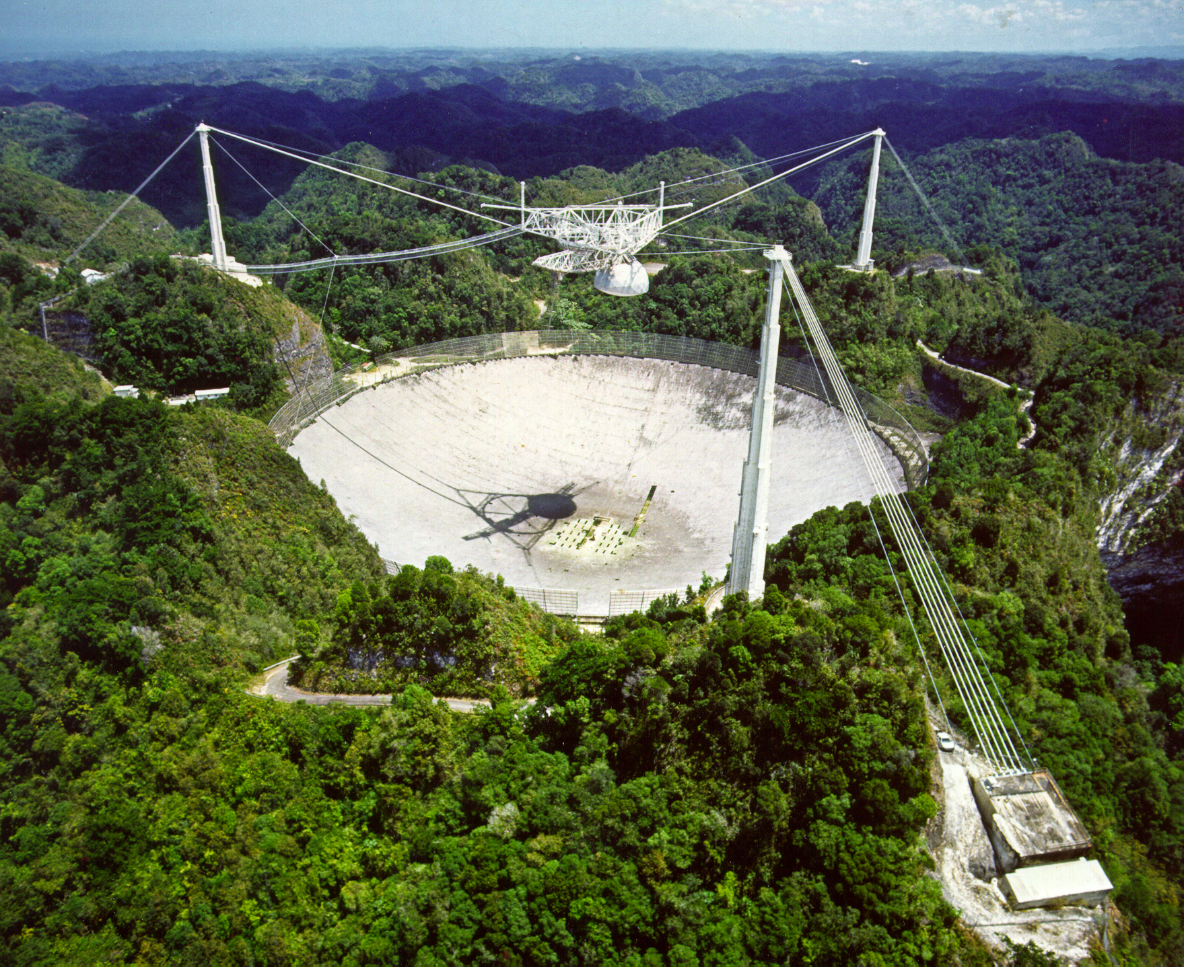
Single dish radio telescopes
Green Bank Telescope - 100m
Arecibo Observatory - 305m
Credit : NRAO/AUI/NSF
Credit : NAIC

Slide 3
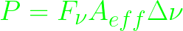
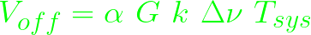
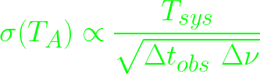
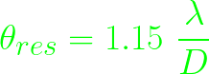
Single dish - Continuum observations
Power collected by a telescope : But in practice, its more complicated - Switched power observations
Voltage on source :
Voltage off source :
But, the gain G is actually time dependant - Dicke Switching
T_{sys} Calculation - Noise diode
T_{A} Calculation - Radiometer equation -
Resolution -
Planning an observation

Slide 4
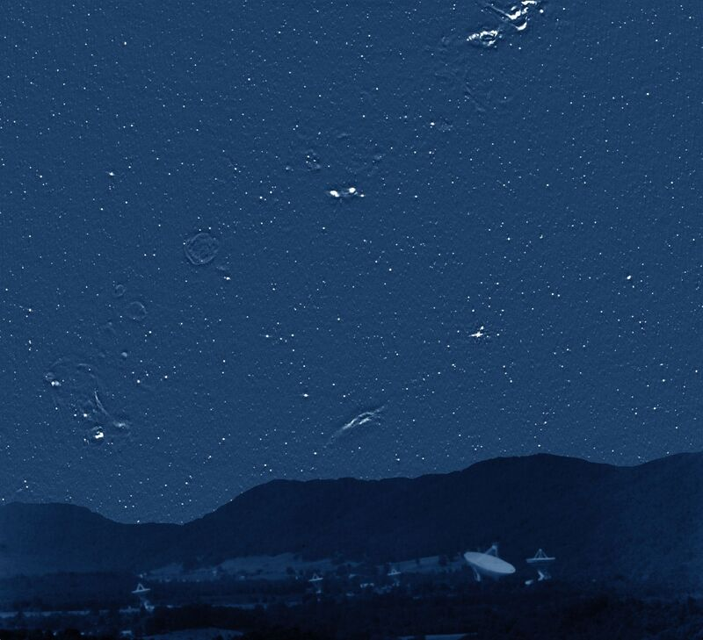
Single dish - Making a map of the sky
Calibrating Gains - from observations of a known point source
A map of the radio sky at 4.85 GHz from NRAO 91m telescope at Green Bank
Condon J. J et al. 1994
Credit : NRAO/AUI/NSF
Spectral and polarimetric observations are a bit more involved

Slide 5
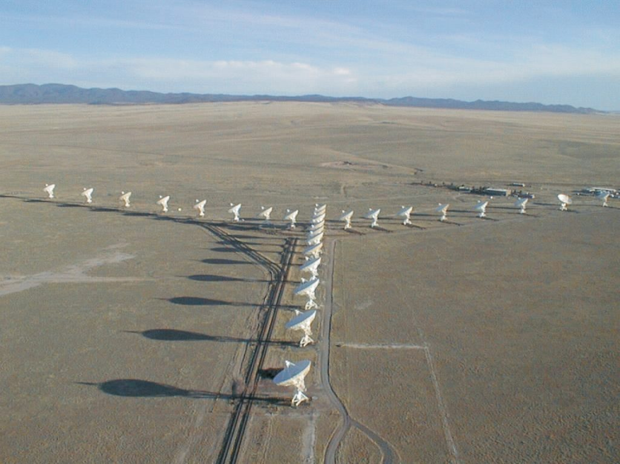
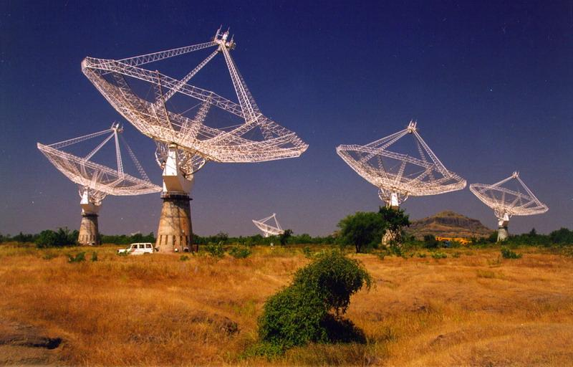
Aperture synthesis (many dishes work as one large telescope)
Resolution of typical optical telescopes ≈ 1 arcsec = 2×10⁻⁵ radians
Size of a radio telescope for similar resolution at (𝜆=10cm) ≈ 10cm/2×10⁻⁵ = 5km
Aperture synthesis - resolution ≈ telescope the size of the longest baseline. NOT sensitivity
Jansky VLA, USA
GMRT, India
Credit : NRAO/AUI/NSF
Credit : http://www.gmrt.ncra.tifr.res.in/

Slide 6

Basic two element interferometer

Slide 7
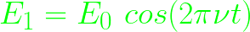
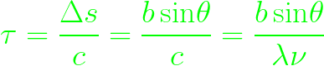
Observing a single point source
The electric fields at the two antennas are
Here the time delay between the antennae is
Avg over time of the product of E₁ and E₂
Response to a point source oscillates with time - Fringe function

Slide 8
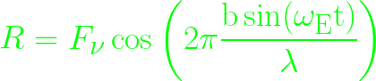
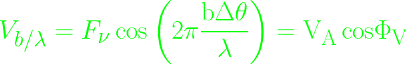
Observing a single point source
Flux calibration : observe a bright source of known flux density
Amplitude of fringes equals flux density of point source Phase (position) calibration : repeatedly (between scans of target) observe another bright source of known position (preferably point source) close to the source of interest
Visibility equation

Slide 9
For a point source at the phase center
Amplitude
Phase
baseline/wavelength
baseline/wavelength

Slide 10
For a point source at the phase center
Amplitude
Phase
baseline/wavelength
baseline/wavelength

Slide 11
For a point source away from the phase center
Amplitude
Phase
baseline/wavelength
baseline/wavelength

Slide 12
For a point source away from the phase center
Amplitude
Phase
baseline/wavelength
baseline/wavelength

Slide 13
Amplitude
For an extended uniform source
Diffraction pattern of a single slit!
baseline/wavelength

Slide 14
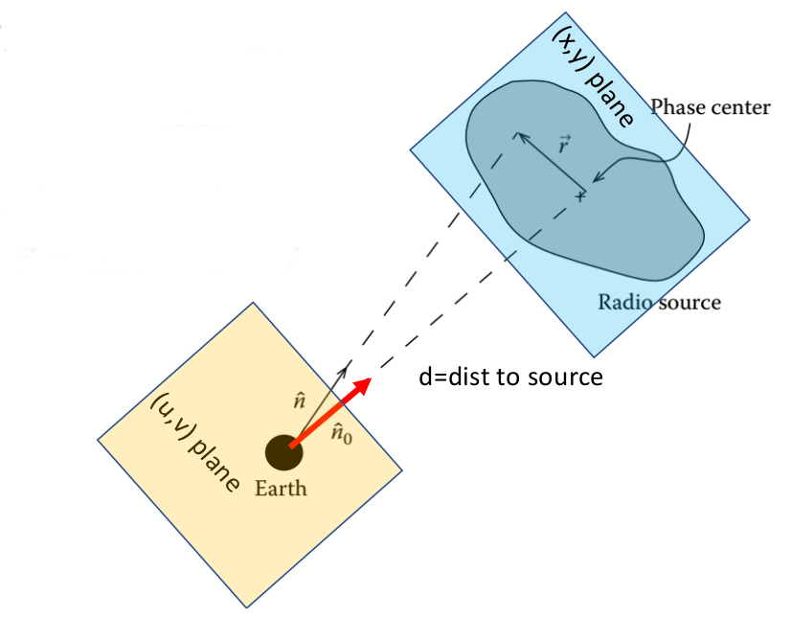
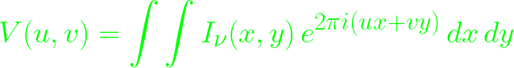
General extended source

Slide 15
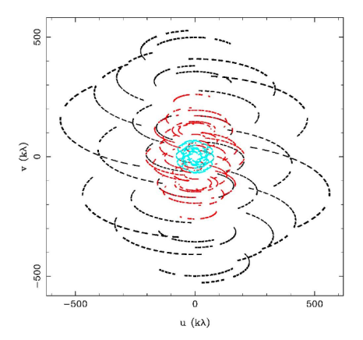
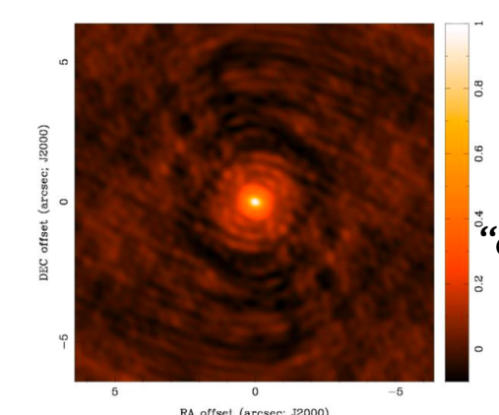
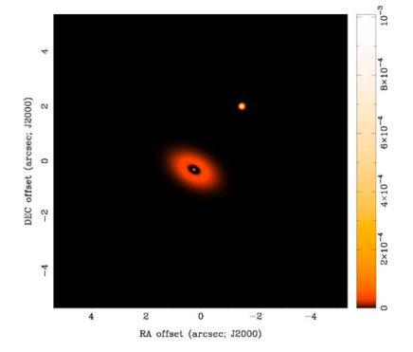
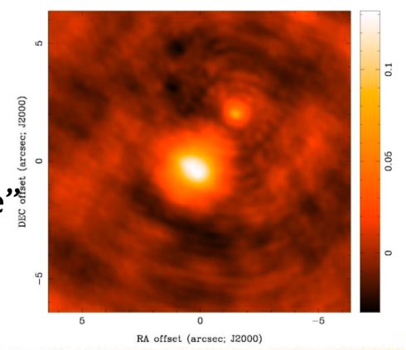
In practise
Dirty beam
ℱ
Convolution
Dirty image
Sky brightness

Slide 16
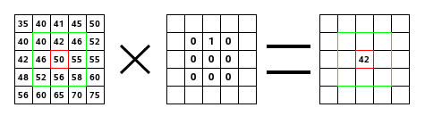
Backup
Convolution

